Slide 1

Data – Machine Learning Skewness, Distribution
Diptangshu Banik
Twitter - @dipbanik

Slide 2
Overview
Mean – Average of all data points
Median – Middle value of data points
Mode – Most common element in the set
Standard Deviation – Average amount we expect a point to differ or deviate from the mean.

Slide 3
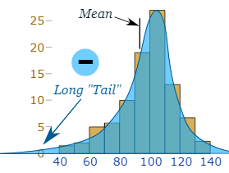
Skewed Data
Left Skewed Data –

Slide 4
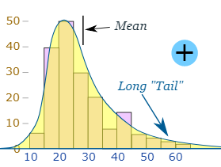
Right Skewed Data –

Slide 5
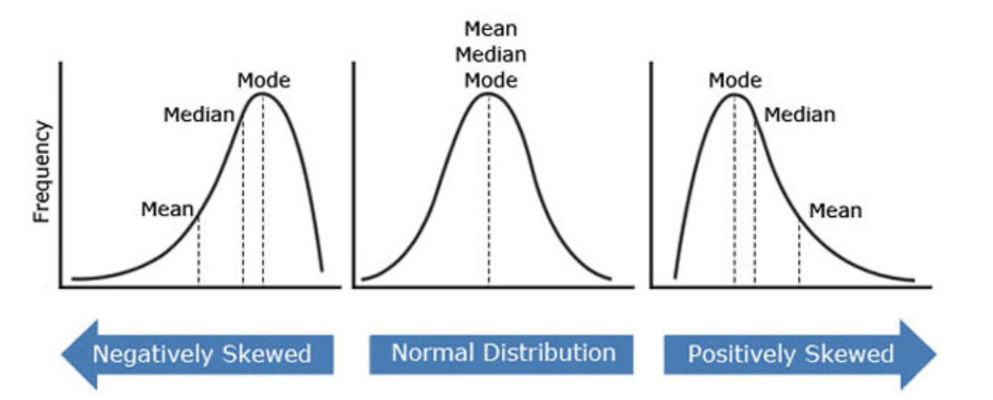
Symmetric Data –

Slide 6
Standard Deviation (σ)
Used to understand the distribution of data.
Use when distribution of data is approximately normal. Not when there are multiple dunes.
Low – Data is closely clustered around mean.
High – Data is dispersed over a wider range of values.

Slide 7
Standard Deviation (σ)
Used to understand the distribution of data.
Use when distribution of data is approximately normal. Not when there are multiple dunes.
Low – Data is closely clustered around mean.
High – Data is dispersed over a wider range of values.

